Slide 1
Backpropagation Algorithm Details
Week 7
Ph.D. Junetae, Kim
Assistant professor

Slide 2
Backpropagation Algorithm Details
Backpropagation Algorithm Review

Slide 3
Backpropagation Algorithm Details
Backpropagation
A method for training the weight matrices of a neural network
Backpropagation is an extended concept of gradient descent.
Basic principle
Calculates the error between the predicted value and the actual value based on weight matrices, and updates the weight matrices iteratively so that the error is minimized.
The backpropagation algorithm is the process of updating the weights (values where the slope becomes 0 when differentiating) that minimize the predicted error.

Slide 4
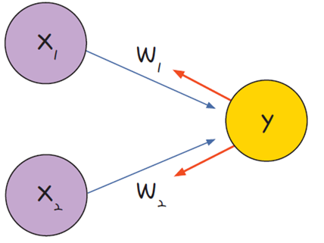
Backpropagation Algorithm Details
Backpropagation
Calculate the error and adjust the weights learned in the previous epoch based on the error
Adjusting the weights
Calculating the error
In the case of perceptron

Slide 5
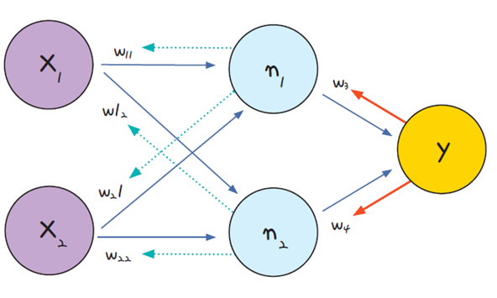
Backpropagation Algorithm Details
Backpropagation
Calculate the error and adjust the weights learned in the previous epoch based on the error
② Adjusting the weights in the hidden layer
① Adjusting the weights in the output layer
Calculating the error
In the case of multilayer perceptron

Slide 6
Backpropagation Algorithm Details
Working procedure of backpropagation
① Predict the outcome values(y_{out}) based on randomly initialized weight matrices(w)
② Calculates the error between the predicted result and the actual value
③ Using gradient descent algorithm, the weights learned in the previous epoch are updated so that the error is small.
④ Repeat the above process until the error no longer decreases.

Slide 7
Backpropagation Algorithm Details
Details in Backpropagation

Slide 8
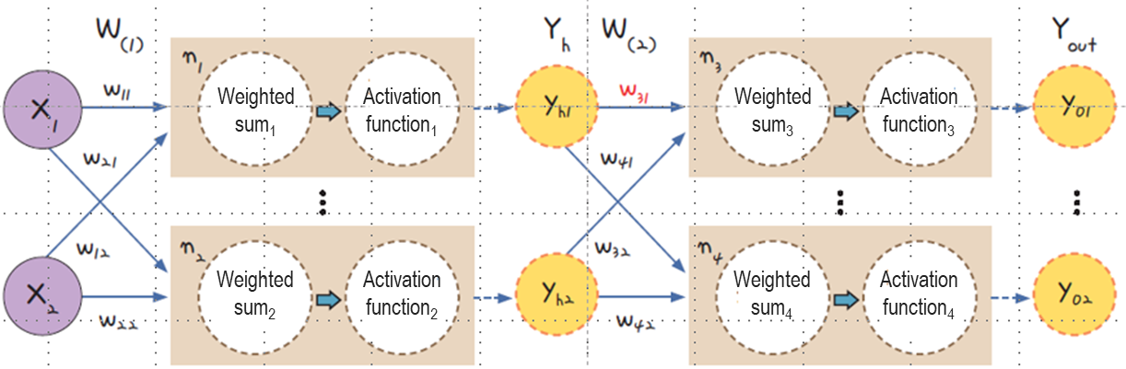

Backpropagation Algorithm Details
Basic structure of MLP
Inside each node, it is divided into a stage of making a weighted sum using input values ​​and a stage of outputting the weighted sum by applying an activation function.
$${Weighted sum}_{1}=w_{11}x_{1}+w_{12}x_{2}$$
$$w_{ij}=trainable parameters$$

Slide 9
Backpropagation Algorithm Details
Basic structure of MLP
Inside each node, it is divided into a stage of making a weighted sum using input values ​​and a stage of outputting the weighted sum by applying an activation function.
$${Activation function}_{1}=G\left({Weighted sum}_{1}\right)=\frac{1}{1+\exp^{−{Weighted sum}_{1}}}$$

Slide 10
Backpropagation Algorithm Details
Backpropagation
Backpropagation is the process of iteratively updating parameters until weight W₍₁₎ and weight W₍₂₎ are no longer updated in the backward direction.
$${Activation function}_{1}=G\left({Weighted sum}_{1}\right)=\frac{1}{1+\exp^{−{Weighted sum}_{1}}}$$

Slide 11
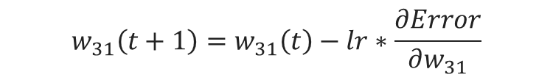
Backpropagation Algorithm Details
How to update W₃₁
To update W₃₁ using the backpropagation, we need to compute as below
$$w_{31}\left(t+1\right)=w_{31}\left(t\right)−lr∗\frac{∂Error}{∂w_{31}}$$

Slide 12
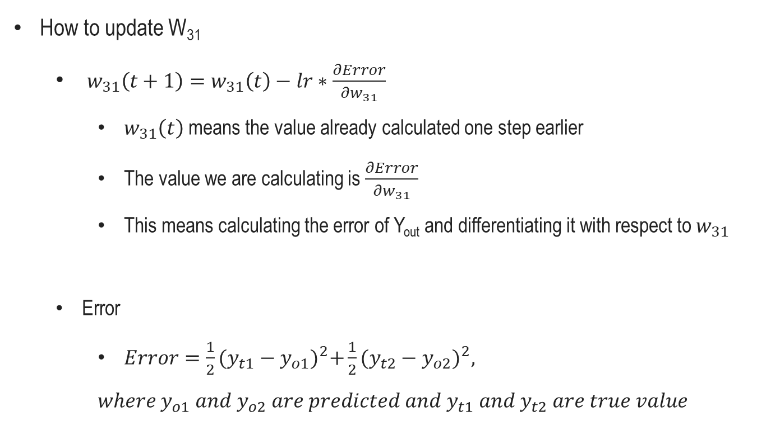
Backpropagation Algorithm Details
How to update W₃₁
$w_{31}\left(t+1\right)=w_{31}\left(t\right)−lr∗\frac{∂Error}{∂w_{31}}$
$w_{31}\left(t\right)$means the value already calculated one step earlier
The value we are calculating is $\frac{∂Error}{∂w_{31}}$
This means calculating the error of Y_{out} and differentiating it with respect to $w_{31}$
Error
$Error=\frac{1}{2}{(y_{t1}−y_{o1})}^{2}+\frac{1}{2}{(y_{t2}−y_{o2})}^{2},$
$$where y_{o1} and y_{o2} are predicted and y_{t1} and y_{t2} are true value$$

Slide 13
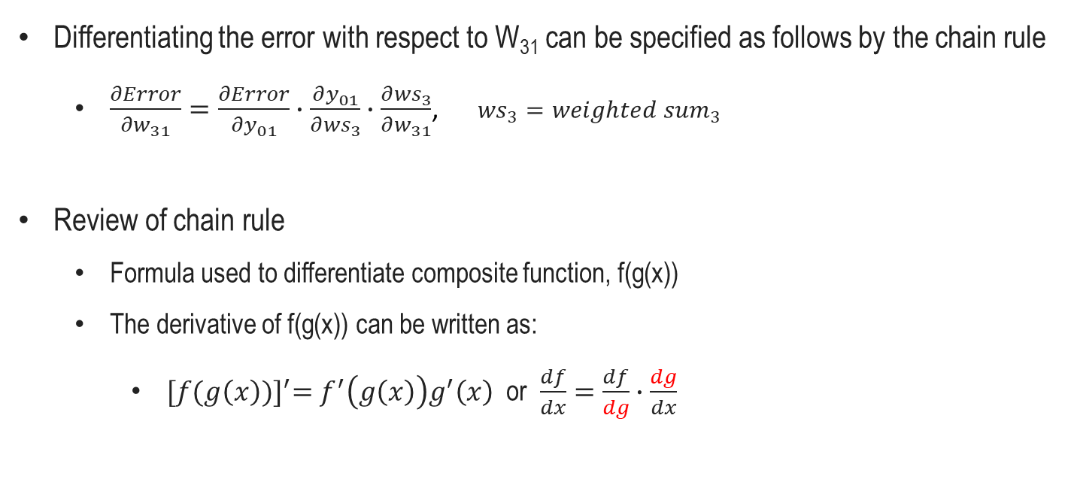
Backpropagation Algorithm Details
Differentiating the error with respect to W₃₁ can be specified as follows by the chain rule
$\frac{∂Error}{∂w_{31}}=\frac{∂Error}{∂y_{01}}∙\frac{∂y_{01}}{∂{ws}_{3}}∙\frac{∂{ws}_{3}}{∂w_{31}}$, ${ws}_{3}={weighted sum}_{3}$
Review of chain rule
Formula used to differentiate composite function, f(g(x))
The derivative of f(g(x)) can be written as:
${[f(g\left(x\right))]}^{′}=f^{′}\left(g\left(x\right)\right)g^{′}\left(x\right)$ or $\frac{df}{dx}=\frac{df}{dg}∙\frac{dg}{dx}$

Slide 14
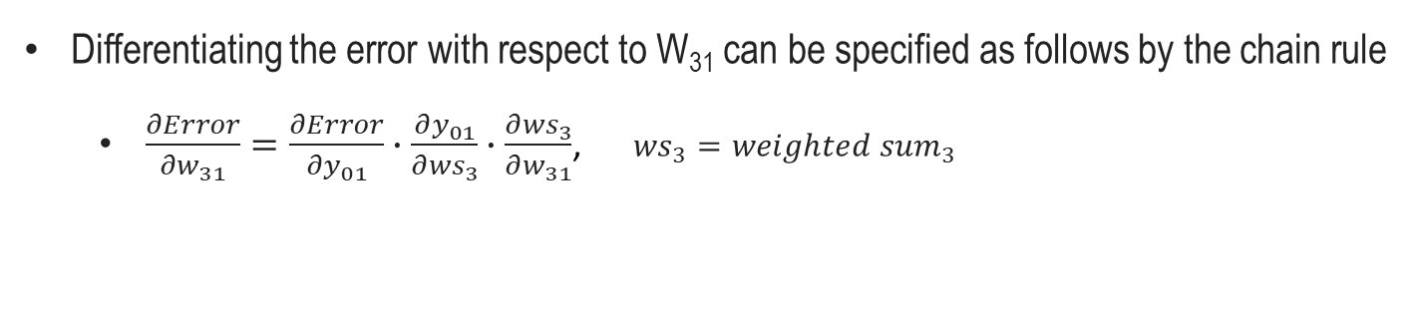
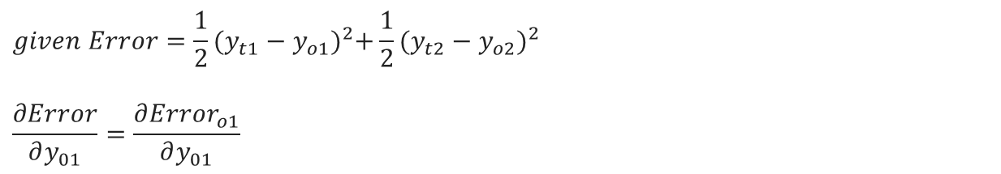
Backpropagation Algorithm Details
Differentiating the error with respect to W₃₁ can be specified as follows by the chain rule
$\frac{∂Error}{∂w_{31}}=\frac{∂Error}{∂y_{01}}∙\frac{∂y_{01}}{∂{ws}_{3}}∙\frac{∂{ws}_{3}}{∂w_{31}}$, ${ws}_{3}={weighted sum}_{3}$
$$given Error=\frac{1}{2}{(y_{t1}−y_{o1})}^{2}+\frac{1}{2}{(y_{t2}−y_{o2})}^{2}$$
$$\frac{∂Error}{∂y_{01}}=\frac{∂{Error}_{o1}}{∂y_{01}}$$

Slide 15
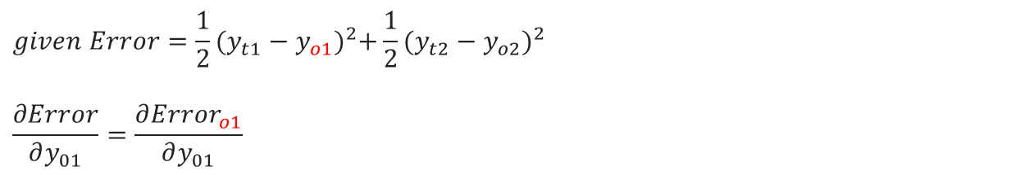
Backpropagation Algorithm Details
Differentiating the error with respect to W₃₁ can be specified as follows by the chain rule
$\frac{∂Error}{∂w_{31}}=\frac{∂Error}{∂y_{01}}∙\frac{∂y_{01}}{∂{ws}_{3}}∙\frac{∂{ws}_{3}}{∂w_{31}}$, ${ws}_{3}={weighted sum}_{3}$
$$given Error=\frac{1}{2}{(y_{t1}−y_{o1})}^{2}+\frac{1}{2}{(y_{t2}−y_{o2})}^{2}$$
$$\frac{∂Error}{∂y_{01}}=\frac{∂{Error}_{o1}}{∂y_{01}}$$

Slide 16

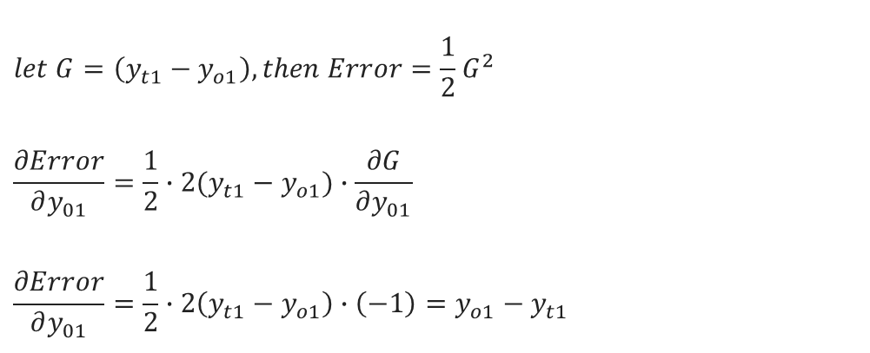
Backpropagation Algorithm Details
Differentiating the error with respect to W₃₁ can be specified as follows by the chain rule
$\frac{∂Error}{∂w_{31}}=\frac{∂Error}{∂y_{01}}∙\frac{∂y_{01}}{∂{ws}_{3}}∙\frac{∂{ws}_{3}}{∂w_{31}}$, ${ws}_{3}={weighted sum}_{3}$
treated as constant with respect to y_{o1}
$$given Error=\frac{1}{2}{(y_{t1}−y_{o1})}^{2}+\frac{1}{2}{(y_{t2}−y_{o2})}^{2}$$
$$let G=\left(y_{t1}−y_{o1}\right), then Error=\frac{1}{2}G^{2}$$
$$\frac{∂Error}{∂y_{01}}=\frac{1}{2}∙2(y_{t1}−y_{o1})∙\frac{∂G}{∂y_{01}}$$
$$\frac{∂Error}{∂y_{01}}=\frac{1}{2}∙2\left(y_{t1}−y_{o1}\right)∙\left(−1\right)=y_{o1}−y_{t1}$$

Slide 17
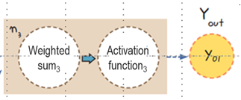

Backpropagation Algorithm Details
Differentiating the error with respect to W₃₁ can be specified as follows by the chain rule
$\frac{∂Error}{∂w_{31}}=\frac{∂Error}{∂y_{01}}∙\frac{∂y_{01}}{∂{ws}_{3}}∙\frac{∂{ws}_{3}}{∂w_{31}}$, ${ws}_{3}={weighted sum}_{3}$
$$\frac{∂y_{01}}{∂{ws}_{3}}=\frac{∂σ({ws}_{3})}{∂{ws}_{3}}$$

Slide 18

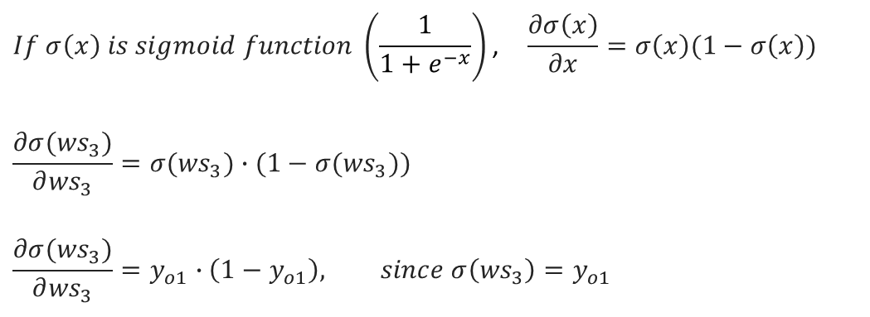
Backpropagation Algorithm Details
Differentiating the error with respect to W₃₁ can be specified as follows by the chain rule
$\frac{∂Error}{∂w_{31}}=\frac{∂Error}{∂y_{01}}∙\frac{∂y_{01}}{∂{ws}_{3}}∙\frac{∂{ws}_{3}}{∂w_{31}}$, ${ws}_{3}={weighted sum}_{3}$
$$\frac{∂y_{01}}{∂{ws}_{3}}=\frac{∂σ({ws}_{3})}{∂{ws}_{3}}$$
$$If σ\left(x\right) is sigmoid function \left(\frac{1}{1+e^{−x}}\right)\text{,} \frac{∂σ\left(x\right)}{∂x}=σ\left(x\right)(1−σ\left(x\right))$$
$$\frac{∂σ({ws}_{3})}{∂{ws}_{3}}=σ({ws}_{3})∙(1−σ({ws}_{3}))$$
$$\frac{∂σ({ws}_{3})}{∂{ws}_{3}}=y_{o1}∙\left(1−y_{o1}\right), since σ\left({ws}_{3}\right)=y_{o1}$$

Slide 19
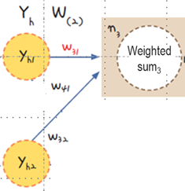
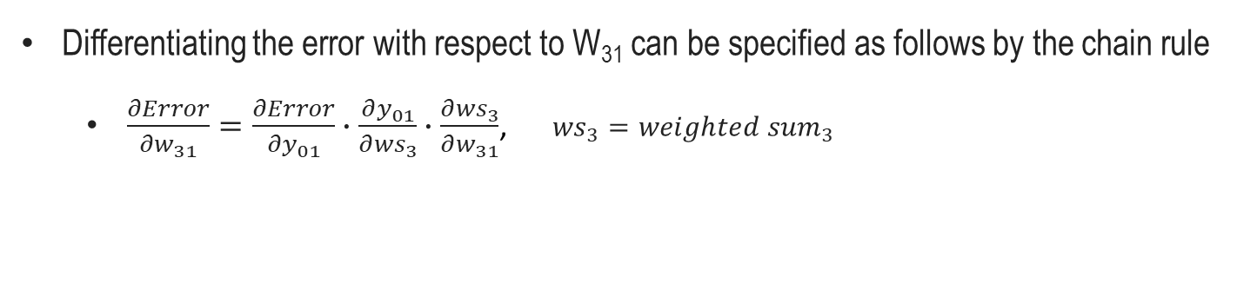

Backpropagation Algorithm Details
Differentiating the error with respect to W₃₁ can be specified as follows by the chain rule
$\frac{∂Error}{∂w_{31}}=\frac{∂Error}{∂y_{01}}∙\frac{∂y_{01}}{∂{ws}_{3}}∙\frac{∂{ws}_{3}}{∂w_{31}}$, ${ws}_{3}={weighted sum}_{3}$
Bias assumed as 1
$${ws}_{3}=w_{31}y_{h1}+w_{41}y_{h2}+1$$
∴ Bias may be learned

Slide 20
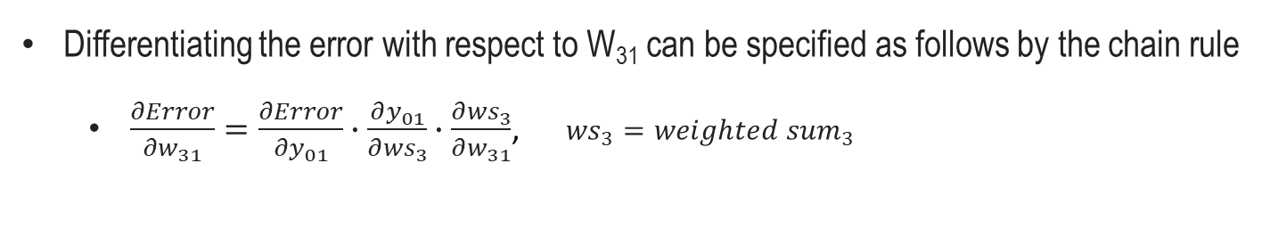
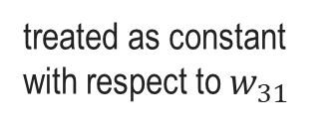
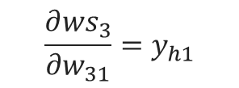

Backpropagation Algorithm Details
Differentiating the error with respect to W₃₁ can be specified as follows by the chain rule
$\frac{∂Error}{∂w_{31}}=\frac{∂Error}{∂y_{01}}∙\frac{∂y_{01}}{∂{ws}_{3}}∙\frac{∂{ws}_{3}}{∂w_{31}}$, ${ws}_{3}={weighted sum}_{3}$
$$Given {ws}_{3}=w_{31}y_{h1}+w_{41}y_{h2}+1$$
treated as constant with respect to $w_{31}$
$$\frac{∂{ws}_{3}}{∂w_{31}}=y_{h1}$$

Slide 21

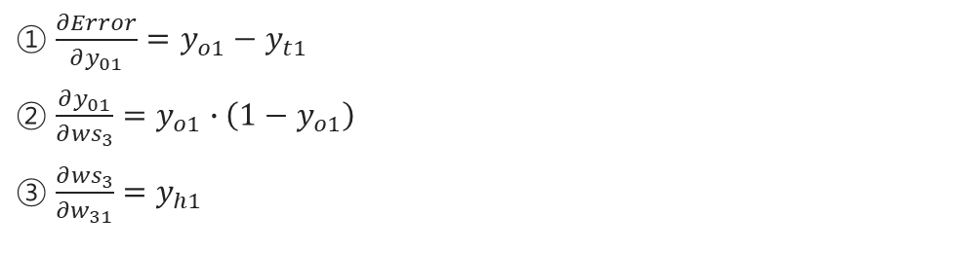
Backpropagation Algorithm Details
Differentiating the error with respect to W₃₁ can be specified as follows by the chain rule
$\frac{∂Error}{∂w_{31}}=\frac{∂Error}{∂y_{01}}∙\frac{∂y_{01}}{∂{ws}_{3}}∙\frac{∂{ws}_{3}}{∂w_{31}}$, ${ws}_{3}={weighted sum}_{3}$
① $\frac{∂Error}{∂y_{01}}=y_{o1}−y_{t1}$
② $\frac{∂y_{01}}{∂{ws}_{3}}=y_{o1}∙\left(1−y_{o1}\right)$
③$\frac{∂{ws}_{3}}{∂w_{31}}=y_{h1}$
$\frac{∂Error}{∂w_{31}}=(y_{o1}−y_{t1})$ $∙$ $y_{o1}\left(1−y_{o1}\right)$ $∙$ $y_{h1}$

Slide 22

Backpropagation Algorithm Details
How to update W₃₁
$w_{31}\left(t+1\right)=w_{31}\left(t\right)−lr∗\frac{∂Error}{∂w_{31}}$
$w_{31}\left(t+1\right)=w_{31}\left(t\right)−lr∗(y_{o1}−y_{t1}) ∙ y_{o1}\left(1−y_{o1}\right) ∙ y_{h1}$
Delta Rule = $(y_{o1}−y_{t1}) ∙ y_{o1}\left(1−y_{o1}\right)$
Used repeatedly during backpropagation
Let $δ\text{y}\text{ = }(y_{o1}−y_{t1}) ∙ y_{o1}\left(1−y_{o1}\right)$
Thus,
$w_{31}\left(t+1\right)=w_{31}\left(t\right)−δ\text{y} ∙ y_{h1}$

Slide 23
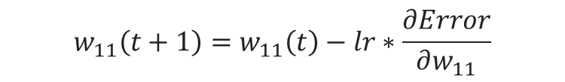
Backpropagation Algorithm Details
How to update W₁₁
To update W₁₁ using the backpropagation, we need to compute as below
$$w_{11}\left(t+1\right)=w_{11}\left(t\right)−lr∗\frac{∂Error}{∂w_{11}}$$

Slide 24
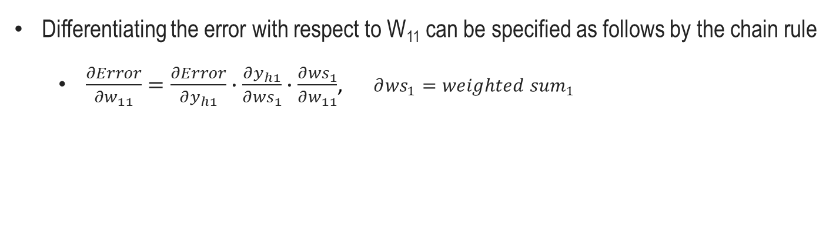
Backpropagation Algorithm Details
Differentiating the error with respect to W₁₁ can be specified as follows by the chain rule
$\frac{∂Error}{∂w_{11}}=\frac{∂Error}{∂y_{h1}}∙\frac{∂y_{h1}}{∂{ws}_{1}}∙\frac{∂{ws}_{1}}{∂w_{11}}$, $∂{ws}_{1}={weighted sum}_{1}$

Slide 25
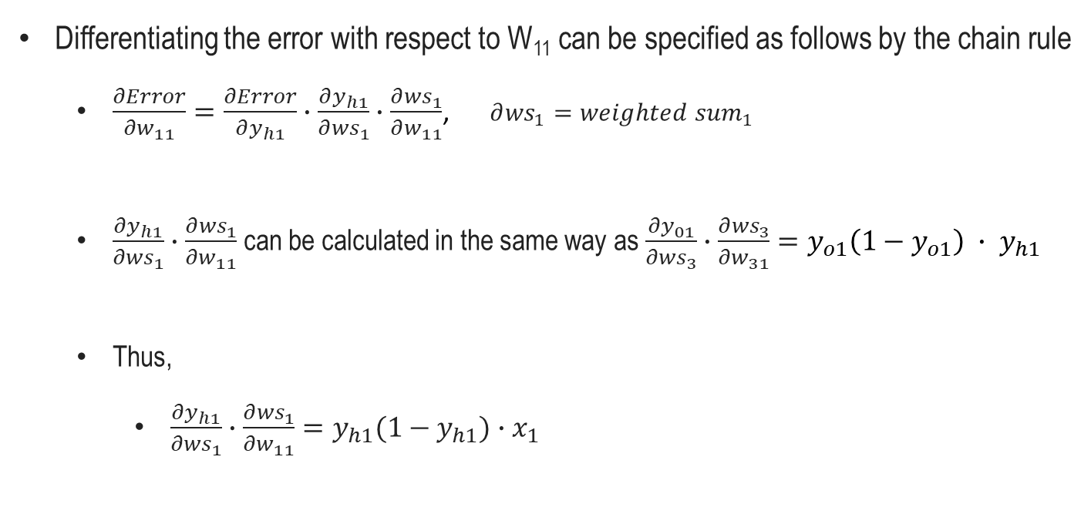
Backpropagation Algorithm Details
Differentiating the error with respect to W₁₁ can be specified as follows by the chain rule
$\frac{∂Error}{∂w_{11}}=\frac{∂Error}{∂y_{h1}}∙\frac{∂y_{h1}}{∂{ws}_{1}}∙\frac{∂{ws}_{1}}{∂w_{11}}$, $∂{ws}_{1}={weighted sum}_{1}$
$\frac{∂y_{h1}}{∂{ws}_{1}}∙\frac{∂{ws}_{1}}{∂w_{11}}$ can be calculated in the same way as $\frac{∂y_{01}}{∂{ws}_{3}}∙\frac{∂{ws}_{3}}{∂w_{31}}=y_{o1}\left(1−y_{o1}\right) ∙ y_{h1}$
Thus,
$\frac{∂y_{h1}}{∂{ws}_{1}}∙\frac{∂{ws}_{1}}{∂w_{11}}=y_{h1}(1−y_{h1})∙x_{1}$
Activate out
Input
Activate out
Input

Slide 26
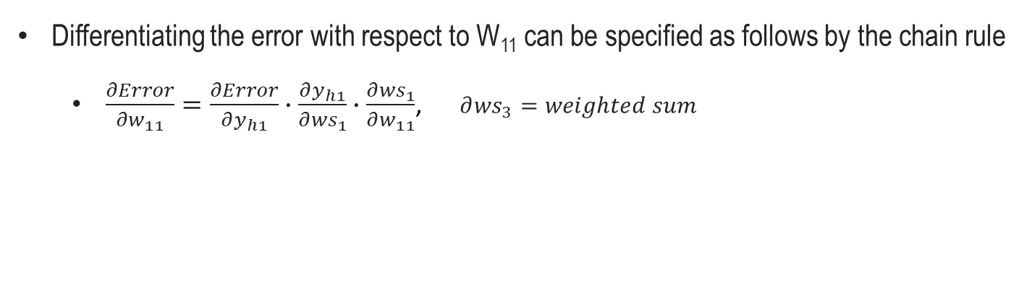

Backpropagation Algorithm Details
Differentiating the error with respect to W₁₁ can be specified as follows by the chain rule
$\frac{∂Error}{∂w_{11}}=\frac{∂Error}{∂y_{h1}}∙\frac{∂y_{h1}}{∂{ws}_{1}}∙\frac{∂{ws}_{1}}{∂w_{11}}$, $∂{ws}_{3}=weighted sum$
$y_{h1}$ is related to both $y_{o1}$ and $y_{o2}$ errors

Slide 27
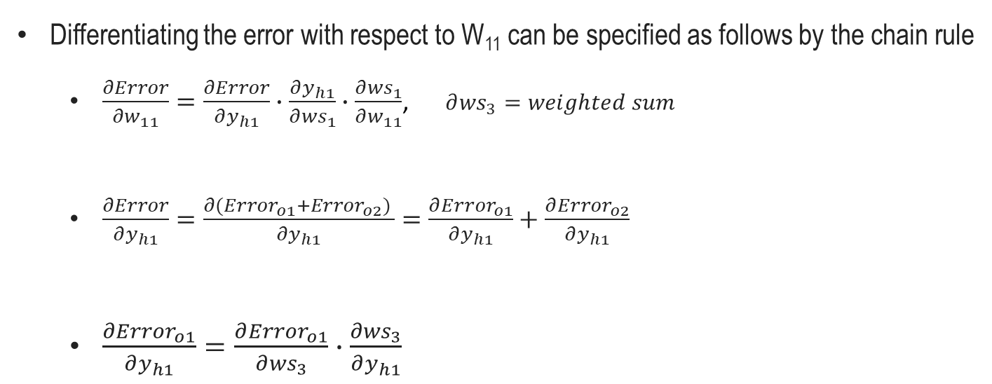
Backpropagation Algorithm Details
Differentiating the error with respect to W₁₁ can be specified as follows by the chain rule
$\frac{∂Error}{∂w_{11}}=\frac{∂Error}{∂y_{h1}}∙\frac{∂y_{h1}}{∂{ws}_{1}}∙\frac{∂{ws}_{1}}{∂w_{11}}$, $∂{ws}_{3}=weighted sum$
$\frac{∂Error}{∂y_{h1}}=\frac{∂({Error}_{o1}+{Error}_{o2}) }{∂y_{h1}}=\frac{∂{Error}_{o1}}{∂y_{h1}}+\frac{∂{Error}_{o2}}{∂y_{h1}}$
$\frac{∂{Error}_{o1}}{∂y_{h1}}=\frac{∂{Error}_{o1}}{∂{ws}_{3}}∙\frac{∂{ws}_{3}}{∂y_{h1}}$
a
b
a-1
a-2

Slide 28
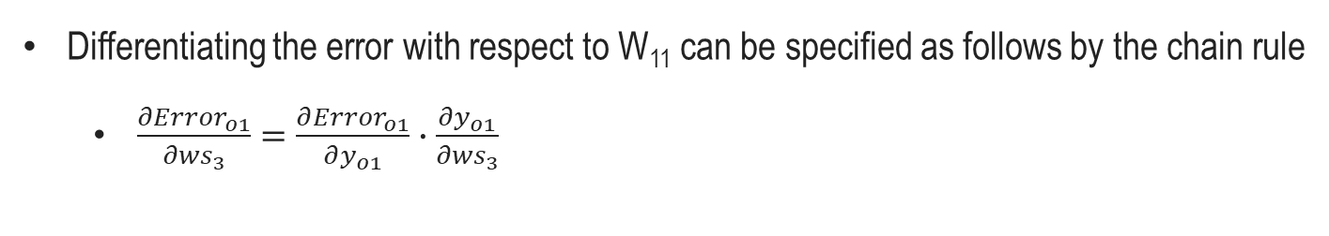
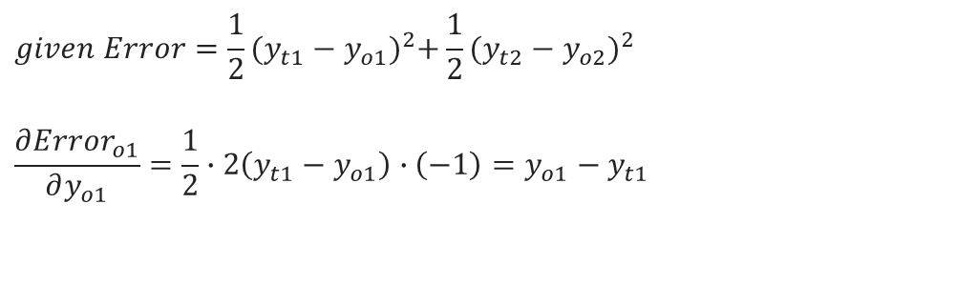
Backpropagation Algorithm Details
Differentiating the error with respect to W₁₁ can be specified as follows by the chain rule
$\frac{∂{Error}_{o1}}{∂{ws}_{3}}=\frac{∂{Error}_{o1}}{∂y_{o1}}∙\frac{∂y_{o1}}{∂{ws}_{3}}$
a-1
$$given Error=\frac{1}{2}{(y_{t1}−y_{o1})}^{2}+\frac{1}{2}{(y_{t2}−y_{o2})}^{2}$$
$$\frac{∂{Error}_{o1}}{∂y_{o1}}=\frac{1}{2}∙2\left(y_{t1}−y_{o1}\right)∙\left(−1\right)=y_{o1}−y_{t1}$$

Slide 29
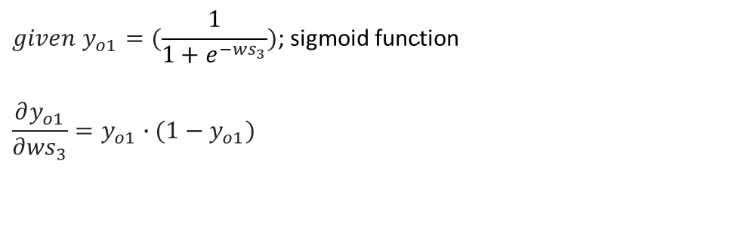
Backpropagation Algorithm Details
Differentiating the error with respect to W₁₁ can be specified as follows by the chain rule
$\frac{∂{Error}_{o1}}{∂{ws}_{3}}=\frac{∂{Error}_{o1}}{∂y_{o1}}∙\frac{∂y_{o1}}{∂{ws}_{3}}$
$$given y_{o1}=(\frac{1}{1+e^{−{ws}_{3}}})\text{; }\text{sigmoid} \text{function}$$
$$\frac{∂y_{o1}}{∂{ws}_{3}}=y_{o1}∙(1−y_{o1})$$

Slide 30
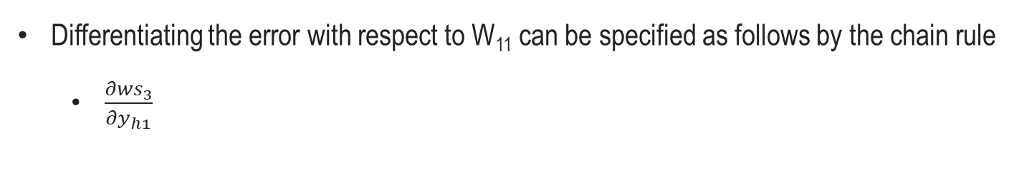
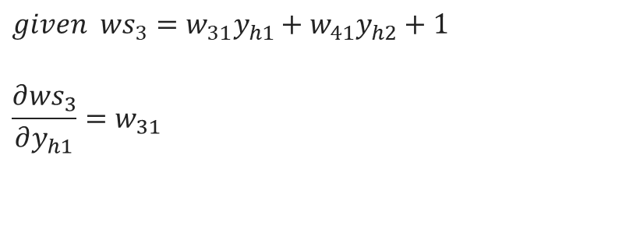
Backpropagation Algorithm Details
Differentiating the error with respect to W₁₁ can be specified as follows by the chain rule
$\frac{∂{ws}_{3}}{∂y_{h1}}$
a-2
$$given {ws}_{3}=w_{31}y_{h1}+w_{41}y_{h2}+1$$
$$\frac{∂{ws}_{3}}{∂y_{h1}}=w_{31}$$

Slide 31

Backpropagation Algorithm Details
Differentiating the error with respect to W₁₁ can be specified as follows by the chain rule
$\frac{∂{Error}_{o1}}{∂y_{h1}}=\frac{∂{Error}_{o1}}{∂{ws}_{3}}∙\frac{∂{ws}_{3}}{∂y_{h1}}$
$\frac{∂{Error}_{o1}}{∂{ws}_{3}}=\left(y_{o1}−y_{t1}\right)∙y_{o1}\left(1−y_{o1}\right)$
$\frac{∂{ws}_{3}}{∂y_{h1}}=w_{31}$
$\frac{∂{Error}_{o1}}{∂y_{h1}}=(y_{o1}−y_{t1})∙y_{o1}(1−y_{o1})∙w_{31}$
a-1
a-2

Slide 32

Backpropagation Algorithm Details
How to update W₃₁
$\frac{∂{Error}_{o1}}{∂y_{h1}}=(y_{o1}−y_{t1})∙y_{o1}(1−y_{o1})∙w_{31}$
Delta Rule = $(y_{o1}−y_{t1}) ∙ y_{o1}\left(1−y_{o1}\right)$
Used repeatedly during backpropagation
Let $δ{\text{y}}_{o1}\text{ = }(y_{o1}−y_{t1}) ∙ y_{o1}\left(1−y_{o1}\right)$
Thus,
$\frac{∂{Error}_{o1}}{∂y_{h1}}=δ{\text{y}}_{o1}∙w_{31}$

Slide 33
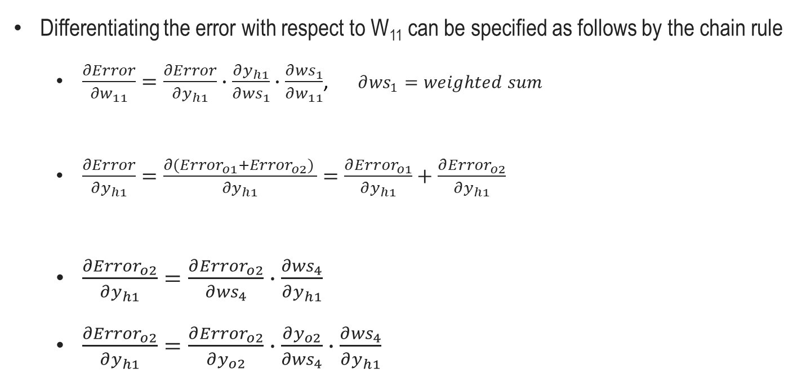


Backpropagation Algorithm Details
Differentiating the error with respect to W₁₁ can be specified as follows by the chain rule
$\frac{∂Error}{∂w_{11}}=\frac{∂Error}{∂y_{h1}}∙\frac{∂y_{h1}}{∂{ws}_{1}}∙\frac{∂{ws}_{1}}{∂w_{11}}$, $∂{ws}_{1}=weighted sum$
$\frac{∂Error}{∂y_{h1}}=\frac{∂({Error}_{o1}+{Error}_{o2}) }{∂y_{h1}}=\frac{∂{Error}_{o1}}{∂y_{h1}}+\frac{∂{Error}_{o2}}{∂y_{h1}}$
$\frac{∂{Error}_{o2}}{∂y_{h1}}=\frac{∂{Error}_{o2}}{∂{ws}_{4}}∙\frac{∂{ws}_{4}}{∂y_{h1}}$
$\frac{∂{Error}_{o2}}{∂y_{h1}}=\frac{∂{Error}_{o2}}{∂y_{o2}}∙\frac{∂y_{o2}}{∂{ws}_{4}}∙\frac{∂{ws}_{4}}{∂y_{h1}}$
a
b
b
b-1
b-2
$$w_{41}$$
$$(y_{o2}−y_{t2}) ∙ y_{o2}\left(1−y_{o2}\right)$$

Slide 34

Backpropagation Algorithm Details
How to update W₃₁
$\frac{∂{Error}_{o2}}{∂y_{h1}}=(y_{o2}−y_{t2}) ∙ y_{o2}\left(1−y_{o2}\right)∙w_{41}$
Delta Rule = $(y_{o2}−y_{t2}) ∙ y_{o2}\left(1−y_{o2}\right)$
Used repeatedly during backpropagation
Let $δ{\text{y}}_{o2} \text{=} (y_{o2}−y_{t2}) ∙ y_{o2}\left(1−y_{o2}\right)$
Thus,
$\frac{∂{Error}_{o2}}{∂y_{h1}}=δ{\text{y}}_{o2}∙w_{41}$

Slide 35
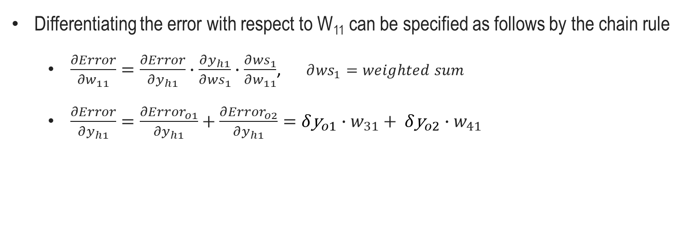
Backpropagation Algorithm Details
Differentiating the error with respect to W₁₁ can be specified as follows by the chain rule
$\frac{∂Error}{∂w_{11}}=\frac{∂Error}{∂y_{h1}}∙\frac{∂y_{h1}}{∂{ws}_{1}}∙\frac{∂{ws}_{1}}{∂w_{11}}$, $∂{ws}_{1}=weighted sum$
$\frac{∂Error}{∂y_{h1}}=\frac{∂{Error}_{o1}}{∂y_{h1}}+\frac{∂{Error}_{o2}}{∂y_{h1}}=δ{\text{y}}_{o1}∙w_{31}+ δ{\text{y}}_{o2}∙w_{41}$

Slide 36
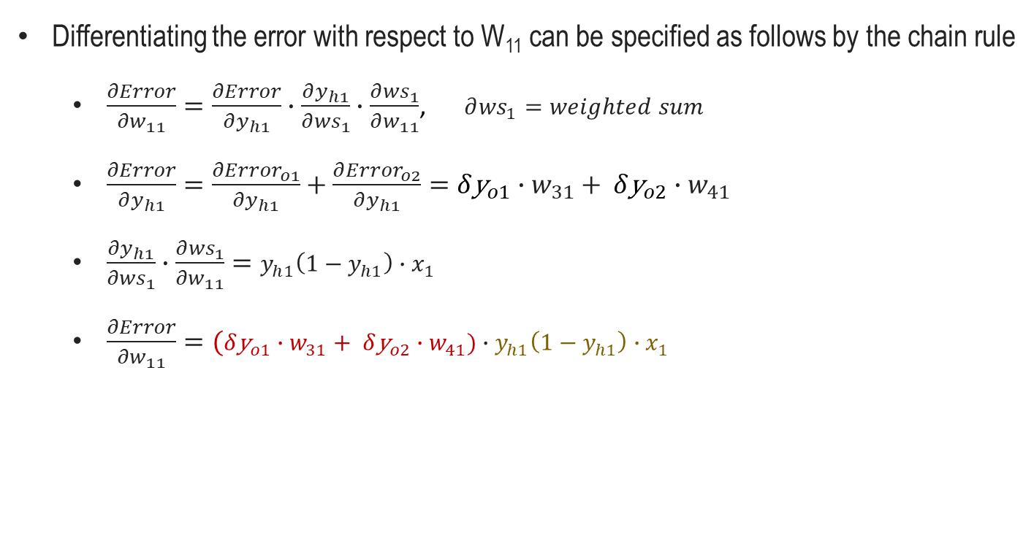
Backpropagation Algorithm Details
Differentiating the error with respect to W₁₁ can be specified as follows by the chain rule
$\frac{∂Error}{∂w_{11}}=\frac{∂Error}{∂y_{h1}}∙\frac{∂y_{h1}}{∂{ws}_{1}}∙\frac{∂{ws}_{1}}{∂w_{11}}$, $∂{ws}_{1}=weighted sum$
$\frac{∂Error}{∂y_{h1}}=\frac{∂{Error}_{o1}}{∂y_{h1}}+\frac{∂{Error}_{o2}}{∂y_{h1}}=δ{\text{y}}_{o1}∙w_{31}+ δ{\text{y}}_{o2}∙w_{41}$
$\frac{∂y_{h1}}{∂{ws}_{1}}∙\frac{∂{ws}_{1}}{∂w_{11}}=y_{h1}\left(1−y_{h1}\right)∙x_{1}$
$\frac{∂Error}{∂w_{11}}=(δ{\text{y}}_{o1}∙w_{31}+ δ{\text{y}}_{o2}∙w_{41})∙y_{h1}\left(1−y_{h1}\right)∙x_{1}$

Slide 37

Backpropagation Algorithm Details
How to update W₁₁
$w_{11}\left(t+1\right)=w_{11}\left(t\right)−lr∗\frac{∂Error}{∂w_{11}}$
$w_{11}\left(t+1\right)=w_{11}\left(t\right)−lr∗(δ{\text{y}}_{o1}∙w_{31}+ δ{\text{y}}_{o2}∙w_{41})∙y_{h1}\left(1−y_{h1}\right)∙x_{1}$
Delta Rule = $(δ{\text{y}}_{o1}∙w_{31}+ δ{\text{y}}_{o2}∙w_{41})∙y_{h1}\left(1−y_{h1}\right)$
Used repeatedly during backpropagation
Let $δ\text{h}\text{ =} (δ{\text{y}}_{o1}∙w_{31}+ δ{\text{y}}_{o2}∙w_{41})∙y_{h1}\left(1−y_{h1}\right)$
Thus,
$w_{11}\left(t+1\right)=w_{11}\left(t\right)−lr∗δ\text{h}∙x_{1}$

Slide 38

Backpropagation Algorithm Details
In summary
$w_{11}\left(t+1\right)=w_{11}\left(t\right)−lr∗δ\text{h}∙x_{1}$
where $δ\text{h}\text{ =} (δ{\text{y}}_{o1}∙w_{31}+ δ{\text{y}}_{o2}∙w_{41})∙y_{h1}\left(1−y_{h1}\right)$
$w_{31}\left(t+1\right)=w_{31}\left(t\right)−lr∗δ\text{y} ∙ y_{h1}$
where $δ\text{y}\text{ = }(y_{o1}−y_{t1}) ∙ y_{o1}\left(1−y_{o1}\right)$

Slide 39
Backpropagation Algorithm Details
Coding exercise for Backpropagation

Slide 40
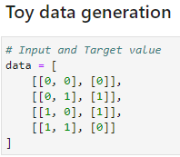
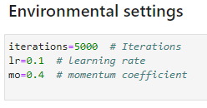

Backpropagation Algorithm Details
The XOR problem data is given as follows
X₁ | X₂ | Result
0 | 0 | 0
0 | 1 | 1
1 | 0 | 1
1 | 1 | 0
We set the number of runs, learning rate, and momentum coefficient.
$$w_{t+1}=mo∗w_{t}−lr∗grad$$
The momentum term helps to accelerate the optimization process in directions with consistent gradients

Slide 41
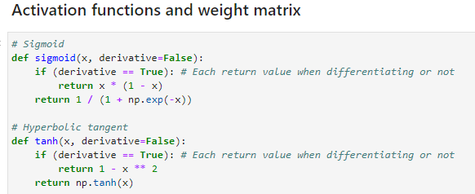
Backpropagation Algorithm Details
Activation functions and weight matrix
Create a sigmoid function and a hyperbolic tangent function
Makes it possible to decide whether to apply differentiation for each function
The derivative of the sigmoid function is output∙(1- output)
The derivative of the hyperbolic tangent function is 1 - (squared output)
In forwardprogation, it is an input, but in backpropagation, it flows backwards, so x is an output.

Slide 42
Backpropagation Algorithm Details
Activation functions and weight matrix
The derivative of the sigmoid function is output∙(1- output)
The derivative of the Sigmoid function is given by:
σ'(x) = σ(x) * (1 - σ(x))
In the provided code, the sigmoid function is implemented with an optional derivative parameter. When this parameter is set to True, the function returns the derivative of the Sigmoid function. However, the code uses a slightly different formula:
x * (1 - x)

Slide 43
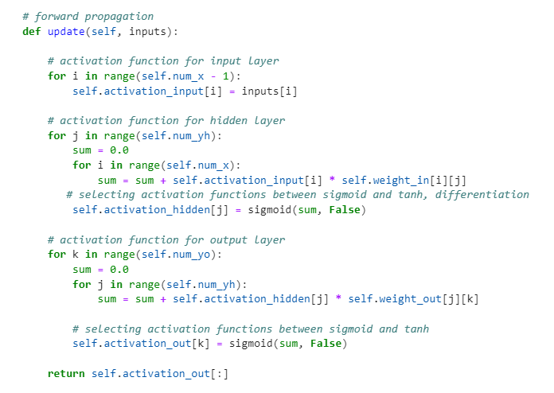
Backpropagation Algorithm Details
Activation functions and weight matrix
This formula is used for computational efficiency. The code assumes that the input x has already been passed through the Sigmoid function. By doing this, the function avoids the need to call the Sigmoid function twice when calculating the derivative, making the computation faster and simpler.
…………………………………………………………………………………………………….......................

Slide 44
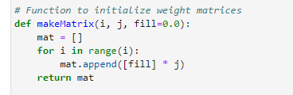
Backpropagation Algorithm Details
Activation functions and weight matrix
Create an array for weights
i and j represent the number of element sizes per dimension of the two-dimensional matrix, respectively.

Slide 45
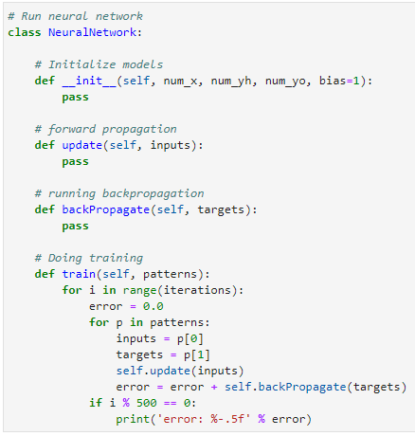
Backpropagation Algorithm Details
A class that implements a neural network
The class consists of an initial value assignment, an update function, and a backpropagation function.

Slide 46
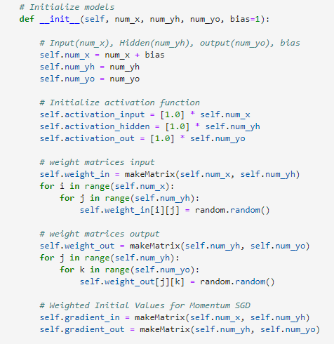
Backpropagation Algorithm Details
A class that implements a neural network
We need the input value, the initial value of the hidden layer, the initial value of the output layer, the bias, and the activation function and the initial value of the weight

Slide 47
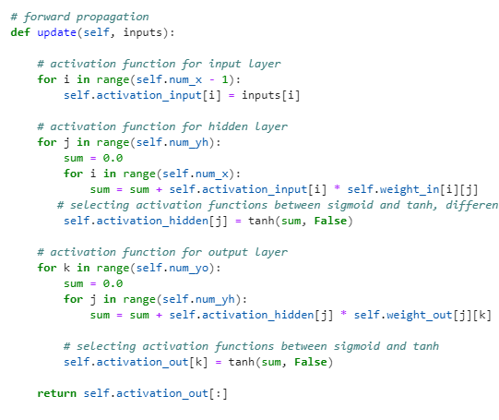
Backpropagation Algorithm Details
A class that implements a neural network
The forward propagation is executed as shown in the code on the right.
Input
Hidden
Output

Slide 48
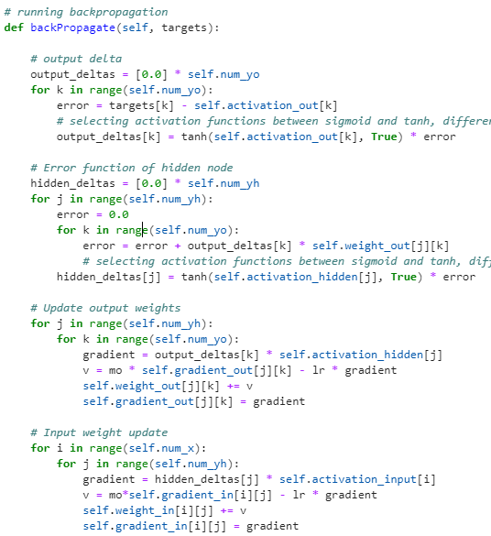
Backpropagation Algorithm Details
A class that implements a neural network
The back propagation is executed as shown in the code on the right.

Slide 49
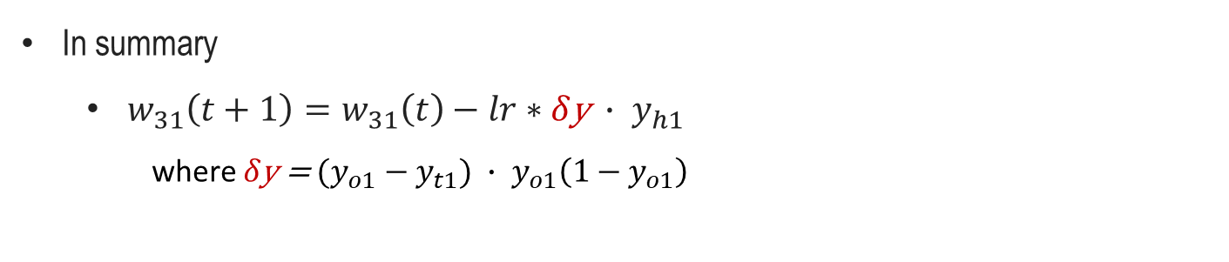
Backpropagation Algorithm Details
In summary
$w_{31}\left(t+1\right)=w_{31}\left(t\right)−lr∗δ\text{y} ∙ y_{h1}$
where $δ\text{y}\text{ = }(y_{o1}−y_{t1}) ∙ y_{o1}\left(1−y_{o1}\right)$

Slide 50
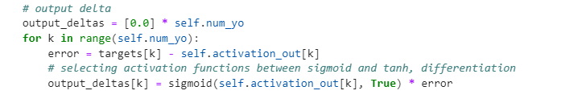
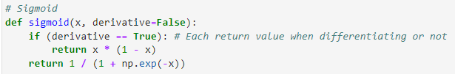
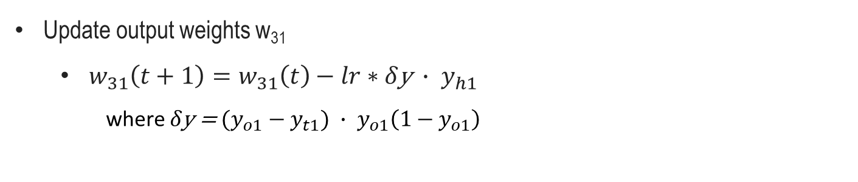
Backpropagation Algorithm Details
Update output weights w₃₁
$w_{31}\left(t+1\right)=w_{31}\left(t\right)−lr∗δ\text{y} ∙ y_{h1}$
where $δ\text{y}\text{ = }(y_{o1}−y_{t1}) ∙ y_{o1}\left(1−y_{o1}\right)$

Slide 51

Backpropagation Algorithm Details
Update output weights w₃₁
$w_{31}\left(t+1\right)=w_{31}\left(t\right)−lr∗δ\text{y} ∙ y_{h1}$
where $δ\text{y}\text{ = }(y_{o1}−y_{t1}) ∙ y_{o1}\left(1−y_{o1}\right)$
Since momentum SGD is utilized, it is slightly different from the above formula. The details are beyond the scope of the class and are not covered.

Slide 52
Backpropagation Algorithm Details
Update output weights w₃₁
$w_{31}\left(t+1\right)=w_{31}\left(t\right)−lr∗δ\text{y} ∙ y_{h1}$
where $δ\text{y}\text{ = }(y_{o1}−y_{t1}) ∙ y_{o1}\left(1−y_{o1}\right)$
The process of updating the previous weight matrix with the current values

Slide 53

Backpropagation Algorithm Details
Update input weights w₁₁
$w_{11}\left(t+1\right)=w_{11}\left(t\right)−lr∗δ\text{h}∙x_{1}$
where $δ\text{h}\text{ =} (δ{\text{y}}_{o1}∙w_{31}+ δ{\text{y}}_{o2}∙w_{41})∙y_{h1}\left(1−y_{h1}\right)$

Slide 54


Backpropagation Algorithm Details
Update input weights w₁₁
$w_{11}\left(t+1\right)=w_{11}\left(t\right)−lr∗δ\text{h}∙x_{1}$
where $δ\text{h}\text{ =} (δ{\text{y}}_{o1}∙w_{31}+ δ{\text{y}}_{o2}∙w_{41})∙y_{h1}\left(1−y_{h1}\right)$
Just initial value for computation

Slide 55
Backpropagation Algorithm Details
Update input weights w₁₁
$w_{11}\left(t+1\right)=w_{11}\left(t\right)−lr∗δ\text{h}∙x_{1}$
where $δ\text{h}\text{ =} (δ{\text{y}}_{o1}∙w_{31}+ δ{\text{y}}_{o2}∙w_{41})∙y_{h1}\left(1−y_{h1}\right)$

Slide 56

Backpropagation Algorithm Details
Update input weights w₁₁
$w_{11}\left(t+1\right)=w_{11}\left(t\right)−lr∗δ\text{h}∙x_{1}$
where $δ\text{h}\text{ =} (δ{\text{y}}_{o1}∙w_{31}+ δ{\text{y}}_{o2}∙w_{41})∙y_{h1}\left(1−y_{h1}\right)$
Since momentum SGD is utilized, it is slightly different from the above formula. The details are beyond the scope of the class and are not covered.

Slide 57
Backpropagation Algorithm Details
Update input weights w₁₁
$w_{11}\left(t+1\right)=w_{11}\left(t\right)−lr∗δ\text{h}∙x_{1}$
where $δ\text{h}\text{ =} (δ{\text{y}}_{o1}∙w_{31}+ δ{\text{y}}_{o2}∙w_{41})∙y_{h1}\left(1−y_{h1}\right)$
The process of updating the previous weight matrix with the current values

Slide 58


Backpropagation Algorithm Details
Cost function
$Error=\frac{1}{2}{(y_{t1}−y_{o1})}^{2}+\frac{1}{2}{(y_{t2}−y_{o2})}^{2}$

Slide 59

Backpropagation Algorithm Details
Doing training
Patterns: Data
Inputs: Input data
Targets: Outcome data

Slide 60
Backpropagation Algorithm Details
Coding for Backpropagation
https://colab.research.google.com/github/JunetaeKim/DeepLearningClass/blob/main/Week7/Week7_XOR_Backpropagation.ipynb

